Slide 1

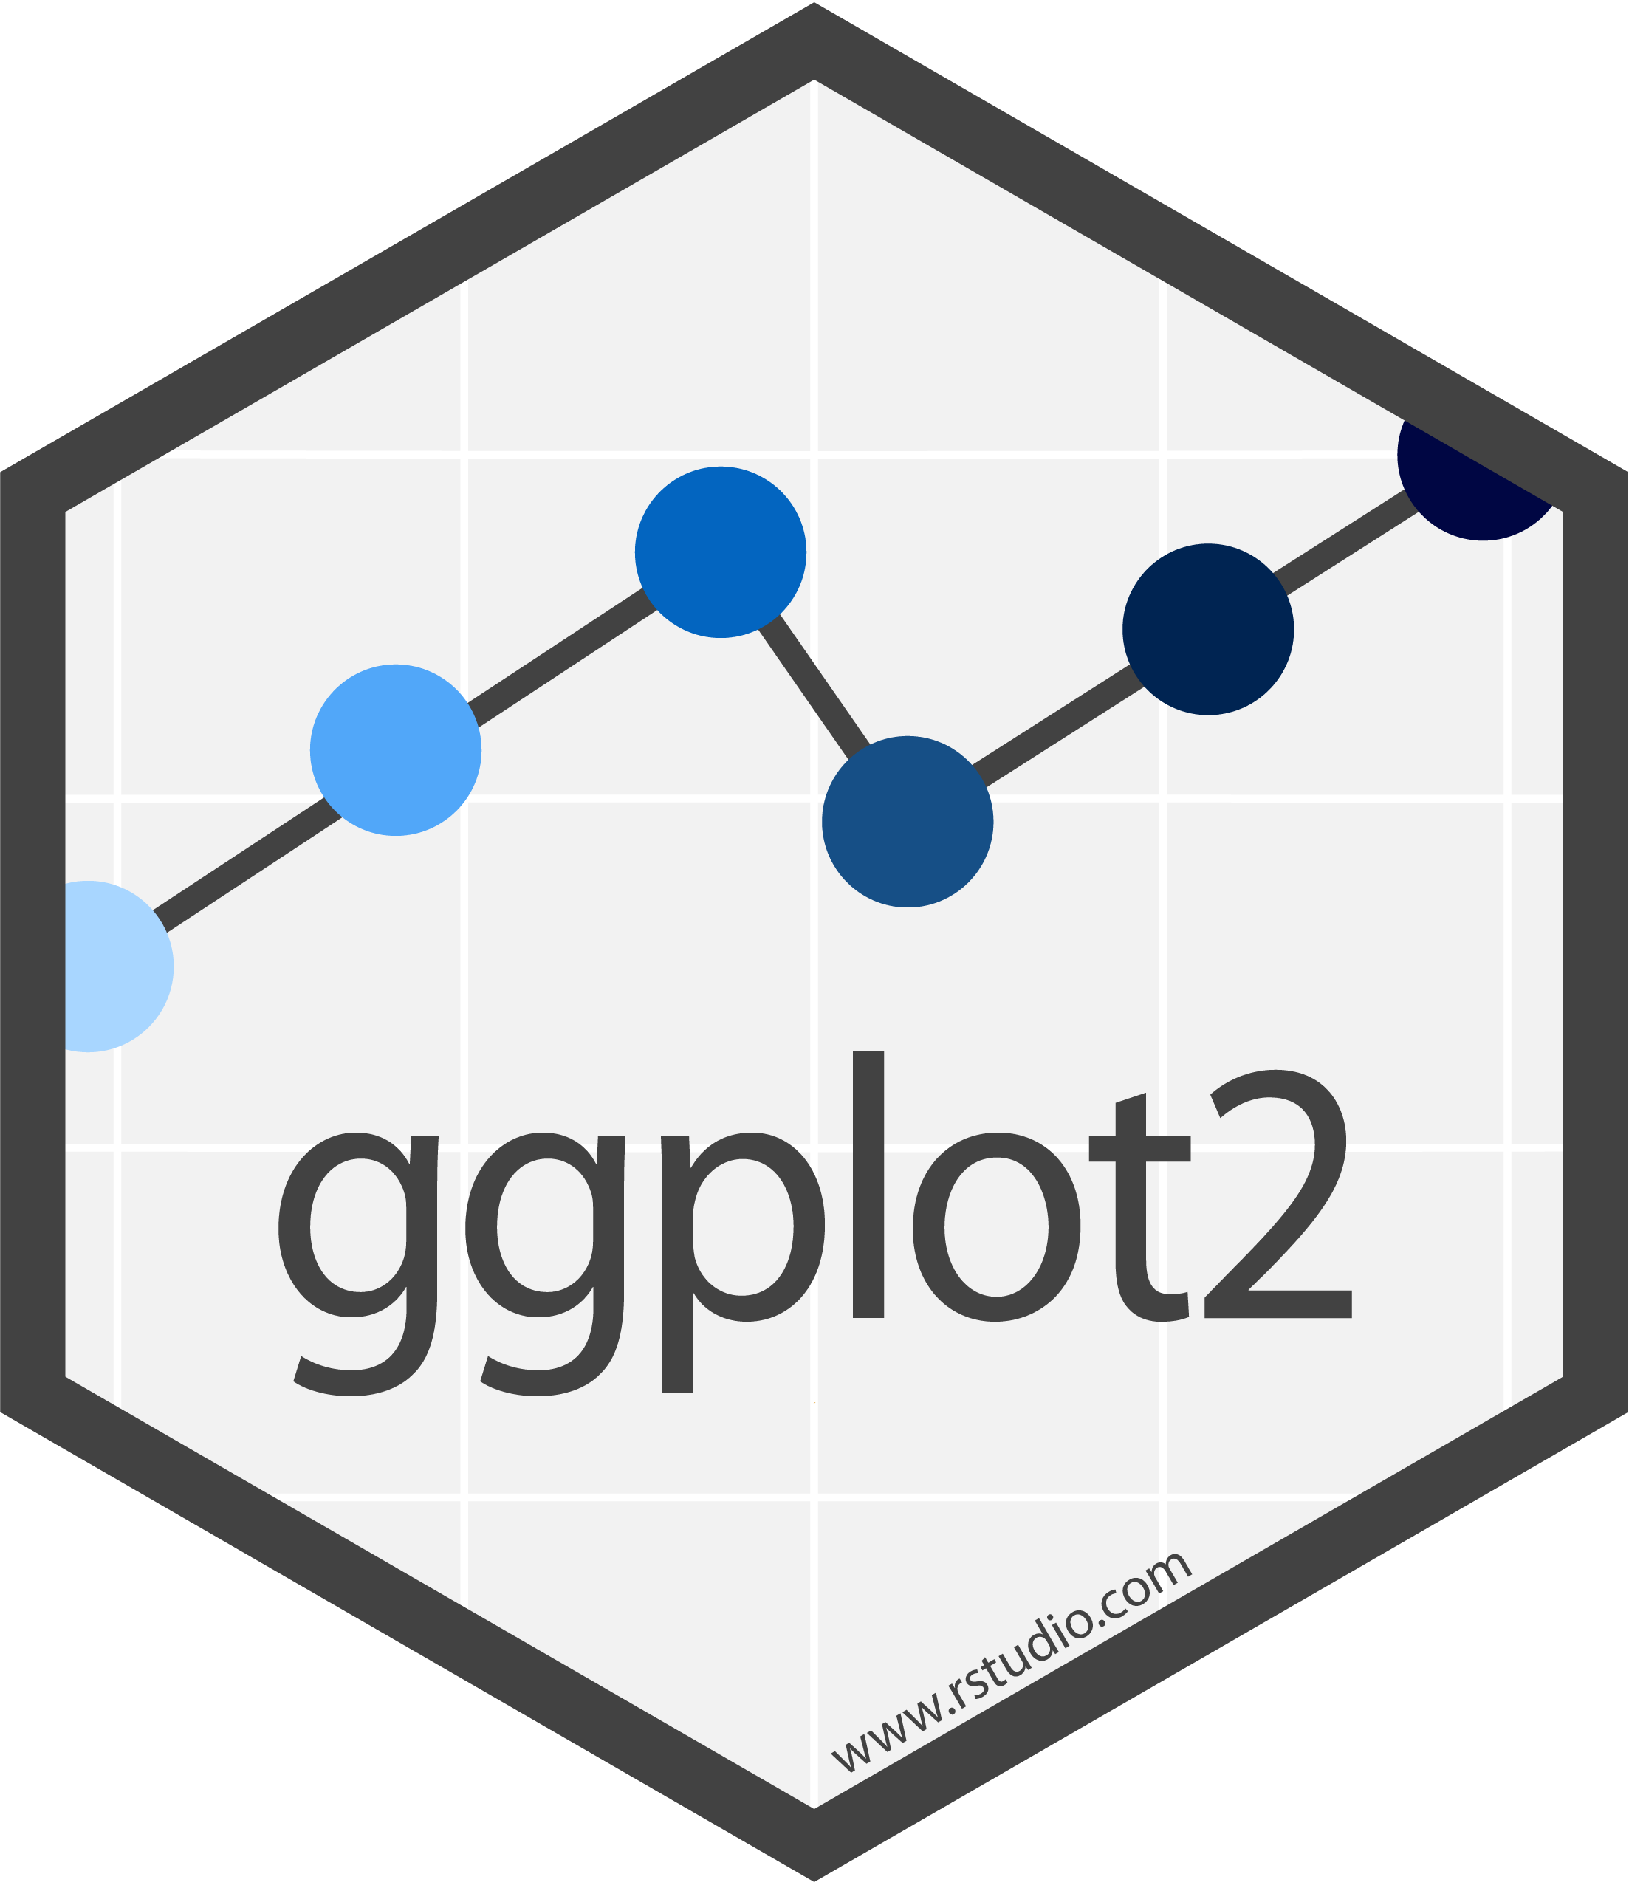


Data Visualization With & ggplot2
Prepared by : Aep Hidayatuloh
Email : aephidayatuloh.mail@gmail.com
GitHub : https://github.com/aephidayatuloh

Slide 2



{Aep Hidayatuloh}
Nama Panggilan | : Aep
Daerah Asal | : Cikarang, Bekasi
Tempat Tinggal | : Cikarang, Bekasi
Angkatan | : STK 46
Pekerjaan | : Senior Data Analyst at Starcore Analytics
 | Customer Value Management at PT Asuransi Jiwa Sequislife
 | Statistician & App Developer at PT Ganesha Cipta Informatika
Github | : https://github.com/aephidayatuloh
Email | : aephidayatuloh.mail@gmail.com
telegram community
R Indonesia
https://t.me/GNURIndonesia

Slide 3
{Prerequisite}

Slide 4


Prerequisite

Slide 5
{Prerequisite}
Internet Connection
Software Installed:
R program [https://cran.r-project.org/]
RStudio [https://www.rstudio.com/products/rstudio/download/]
Data & Scripts:
Download from https://github.com/aephidayatuloh/introggplot2
R Packages:
ggplot2 : install.packages("ggplot2")
Use install.packages(c("ggplot2")) to install all those packages or simply install.packages("tidyverse") to install ggplot2 and other useful packages.

Slide 6
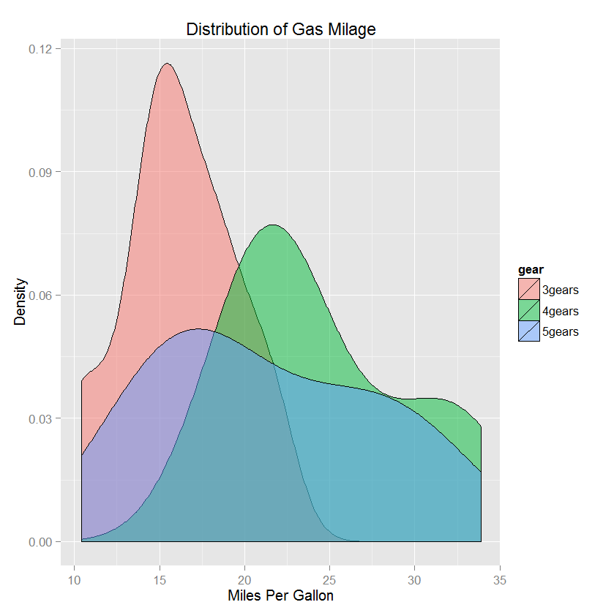
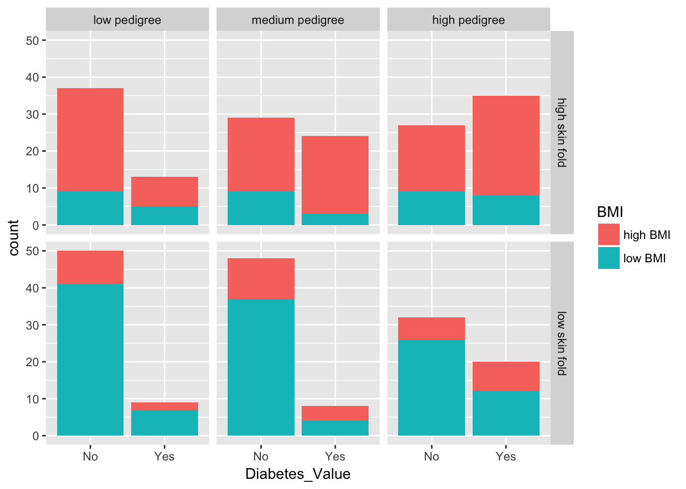
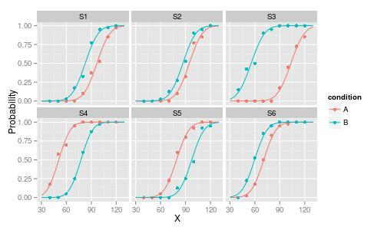
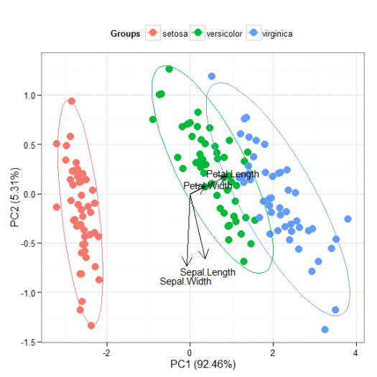
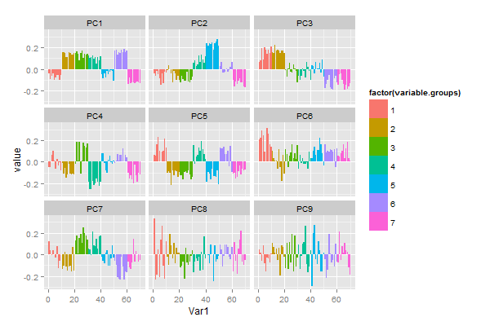
Have Seen Like This?

Slide 7
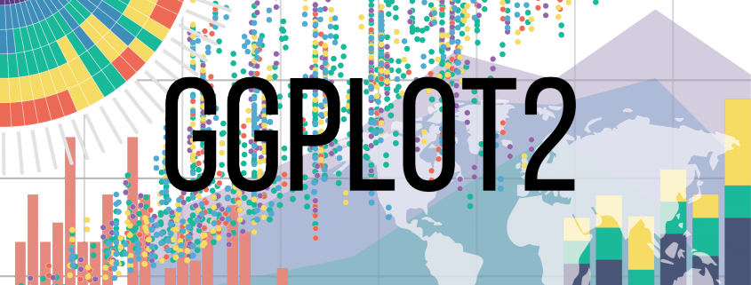
Have Seen Like This?

Slide 8
Objective
understand and able to create data visualization using R & ggplot2
Source and code can be downloaded from
https://github.com/aephidayatuloh/introggplot2
Reference
Wickham, H. 2016. ggplot2 : Elegant Graphics for Data Analysis Second Edition. Texas: Springer.
Grolemund G & Wickham, H. ____. R For Data Science. https://r4ds.had.co.nz.

Slide 9
To be discussed
Basic of ggplot2
Barplot
Histogram & Density
Boxplot
Scatter plot
Line plot
Faceting
Annotation
Theme
ggplot(data, mapping = aes()) +
<geom_function>()

Slide 10
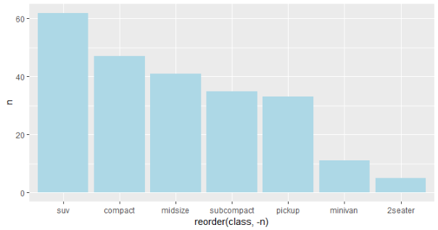
To be discussed
Basic of ggplot2
Barplot
Histogram & Density
Boxplot
Scatter plot
Line plot
Faceting
Annotation
Theme

Slide 11
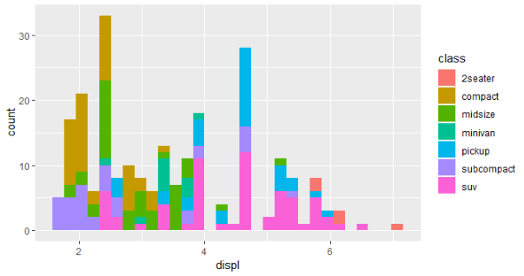
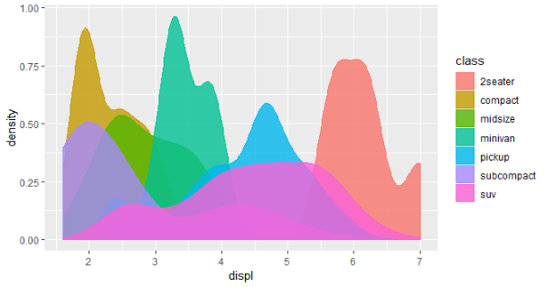
To be discussed
Basic of ggplot2
Barplot
Histogram & Density
Boxplot
Scatter plot
Line plot
Faceting
Annotation
Theme

Slide 12
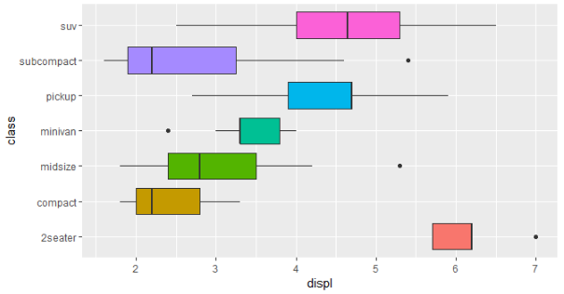
To be discussed
Basic of ggplot2
Barplot
Histogram & Density
Boxplot
Scatter plot
Line plot
Faceting
Annotation
Theme

Slide 13
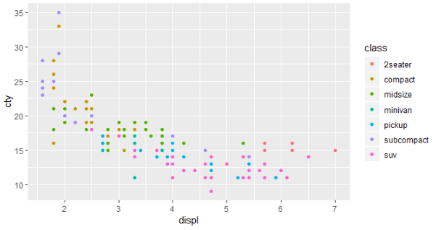
To be discussed
Basic of ggplot2
Barplot
Histogram & Density
Boxplot
Scatter plot
Line plot
Faceting
Annotation
Theme

Slide 14
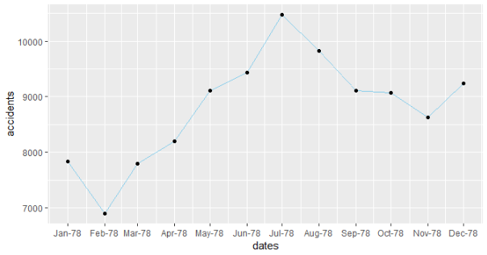
To be discussed
Basic of ggplot2
Barplot
Histogram & Density
Boxplot
Scatter plot
Line plot
Faceting
Annotation
Theme

Slide 15
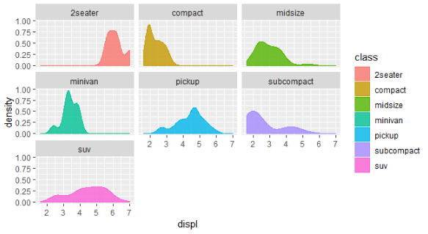
To be discussed
Basic of ggplot2
Barplot
Histogram & Density
Boxplot
Scatter plot
Line plot
Faceting
Annotation
Theme

Slide 16
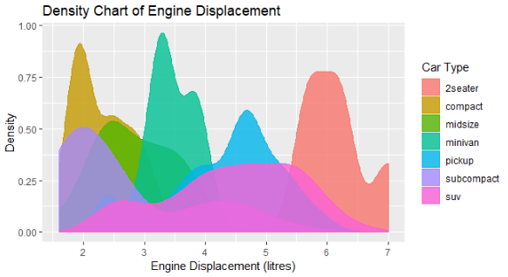
To be discussed
Basic of ggplot2
Barplot
Histogram & Density
Boxplot
Scatter plot
Line plot
Faceting
Annotation
Theme

Slide 17
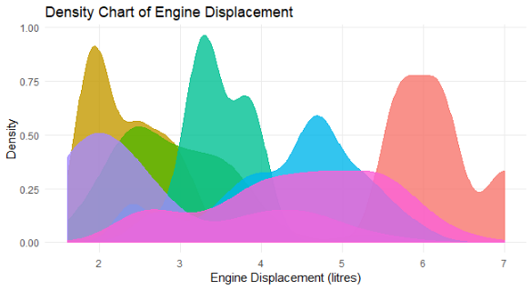
To be discussed
Basic of ggplot2
Barplot
Histogram & Density
Boxplot
Scatter plot
Line plot
Faceting
Annotation
Theme

Slide 18
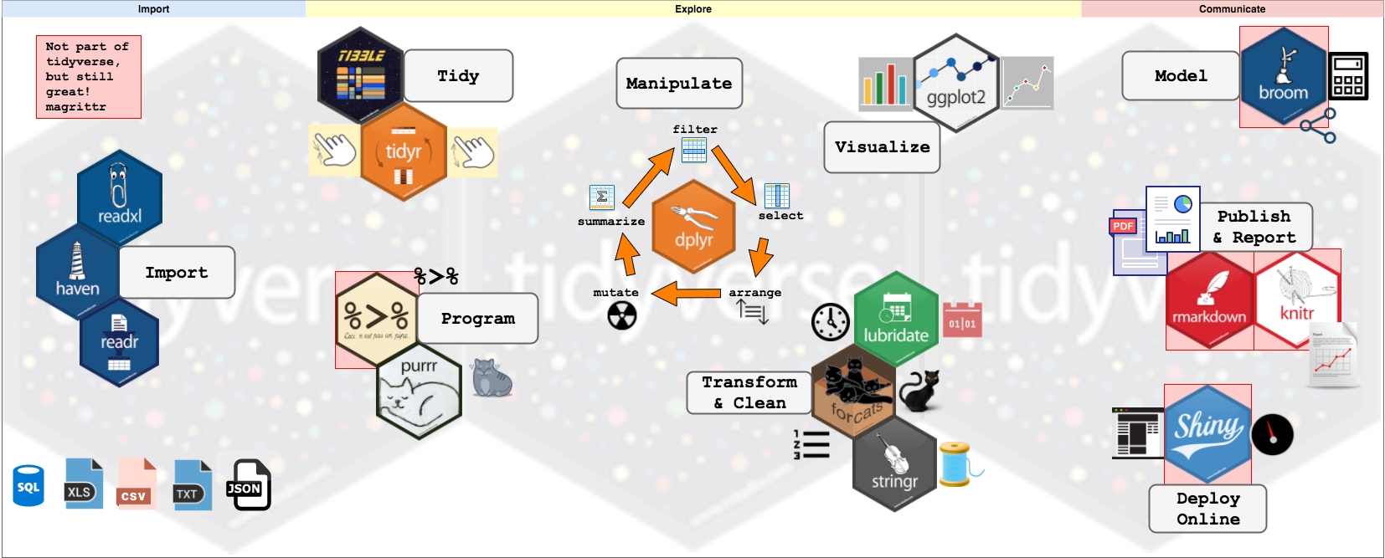
Tidyverse and Data Flow

Slide 19

The ggplot2, dplyr and pipe
Awesome Visualization
Great package for data visualization in R
Powerful data management
Data manipulation and transformation in R became so easy
Pipeline in R
The dplyr imports this operator from another package (magrittr)
It’s the And Then

Slide 20
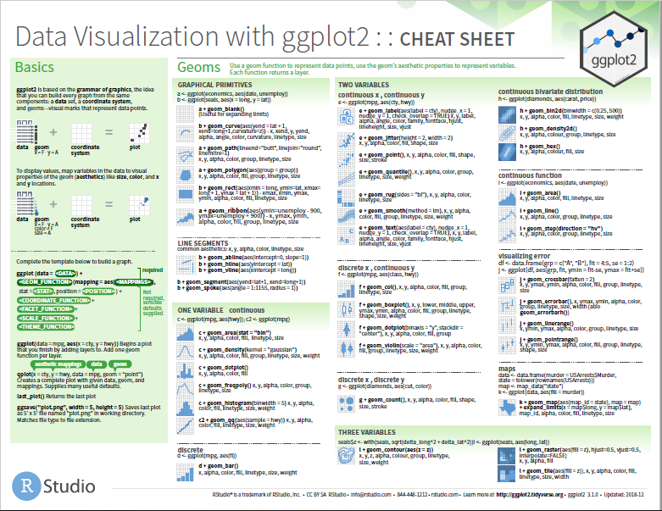
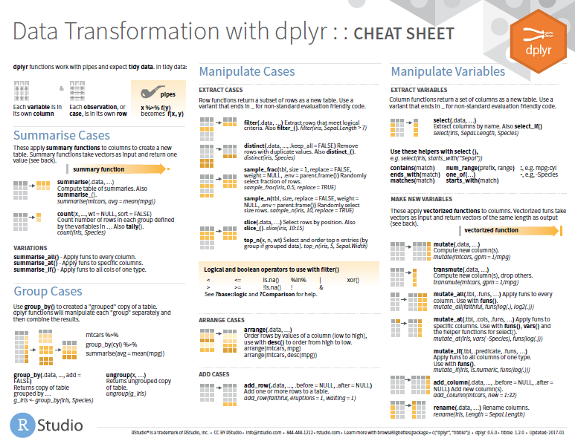
Cheat Sheets
https://www.rstudio.com/resources/cheatsheets/

Slide 21
Basic of ggplot2

Slide 22
Load Packages & Data
library(ggplot2)
library(dplyr)
mpg # from ggplot2
str(mpg)
Variable | Description
manufacturer | Car manufacturer
model | Model name
displ | Engine displacement, in litres
year | Year of manufacture
cyl | Number of cylinders
trans | Type of transmission
drv | f = front-wheel drive, r = rear wheel drive, 4 = 4wd
cty | City miles per gallon
hwy | Highway miles per gallon
fl | Fuel type
class | "Type" of car
mpg :
Fuel economy data from 1999 and 2008 for 38 popular models of car

Slide 23
Basic of ggplot2
System for declaratively creating graphics, based on The Grammar of Graphics¹.
ggplot(data = <dfn>, mapping = aes(x = <x>[, y = <y>, fill = <var>, color = <var>])) +
<geom_function>(<args>)
Provide the data,
Tell ggplot2 how to map variables to aesthetics (x = ?, y = ?),
What graphical primitives to use (geom, annotation, etc), and
It takes care of the details.

Slide 24
Barplot

Slide 25
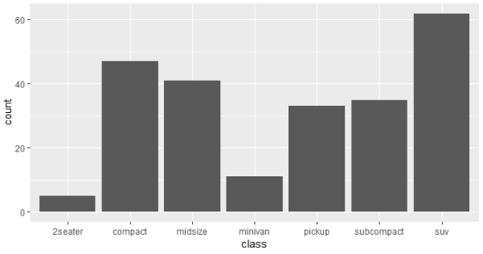
Barplot – geom_bar()
Q :
What types of cars are there?
What are the most types of cars?
A :
Use mpg dataframe
Mapping class variable to x in aes()
Use geom_bar()

Slide 26
Barplot – geom_bar()
Solution:
ggplot(data = mpg, mapping = aes(x = class)) +
geom_bar()

Slide 27
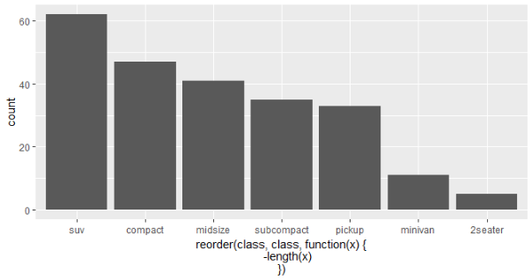
Barplot – geom_bar()
Q :
What types of cars are there?
What are the most types of cars?
Sort by it’s count
A :
Use mpg dataframe
Mapping class variable to x in aes()
Use reorder() function
Use geom_bar()

Slide 28
Barplot – geom_bar()
Solution:
ggplot(data = mpg,
mapping = aes(x = reorder(class, class, function(x){-length(x)} ))) +
geom_bar()

Slide 29

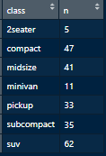

Barplot – geom_bar()
?
sum_tbl <- as.data.frame(table(mpg$class, dnn = list("class")),
responseName = "n")

Slide 30

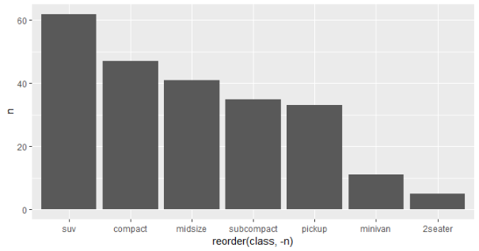
Barplot – geom_bar()
Solution:
ggplot(data = sum_tbl,
mapping = aes(x = class, y = n)) +
geom_bar(stat = "identity")
Solution (sorted):
ggplot(data = sum_tbl,
mapping = aes(x=reorder(class, -n),
y = n)) +
geom_bar(stat = "identity")

Slide 31
Barplot – geom_bar()
Change fill color:
ggplot(data = sum_tbl, mapping = aes(x = reorder(class, -n), y = n)) +
geom_bar(stat = "identity", fill = "lightblue")

Slide 32
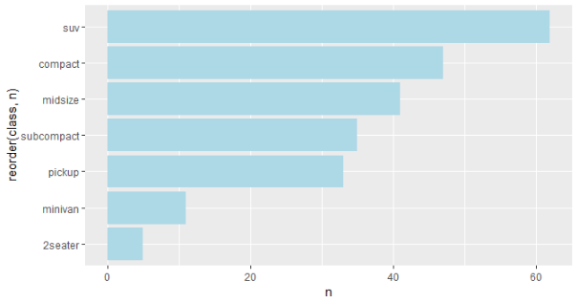
Flipped Barplot – geom_bar()
Flipped :
ggplot(data = sum_tbl, mapping = aes(x = reorder(class, n), y = n)) +
geom_bar(stat = "identity", fill = "lightblue") +
coord_flip()

Slide 33
Histogram & Density

Slide 34
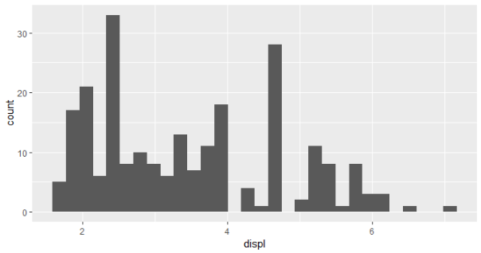
Histogram – geom_histogram()
Q :
How is distribution of engine displacement?
A :
Use mpg dataframe
Mapping displ variable to x in aes()
Use geom_histogram()

Slide 35
Histogram – geom_histogram()
Solution:
ggplot(mpg, aes(x = displ)) +
geom_histogram()

Slide 36
Histogram – geom_histogram()
Q :
How is distribution of engine displacement?
How is distribution of engine displacement by type of car (class)?
A :
Use mpg dataframe
Mapping displ variable to x in aes()
Mapping class variable to fill in aes()
Use geom_histogram()

Slide 37
Histogram – geom_histogram()
Solution:
ggplot(mpg, aes(x = displ, fill = class)) +
geom_histogram()

Slide 38
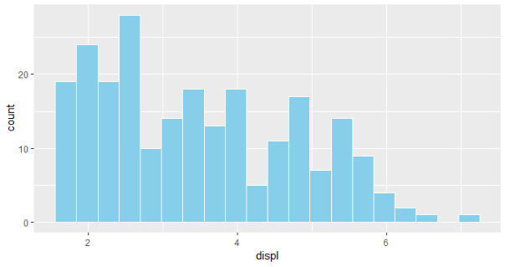
Histogram – geom_histogram()
Custom color & number of bins :
ggplot(mpg, aes(x = displ)) +
geom_histogram(bins = 20, fill = "skyblue", color = "white")

Slide 39
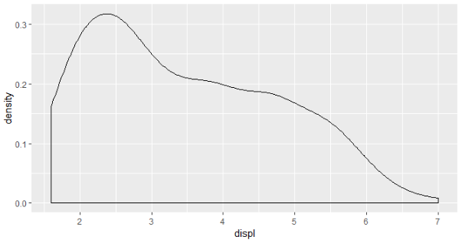
Density – geom_density()
Q :
How is density of engine displacement?
A :
Use mpg dataframe
Mapping displ variable to x in aes()
Use geom_density()

Slide 40
Density – geom_density()
Solution:
ggplot(mpg, aes(x = displ)) +
geom_density()

Slide 41
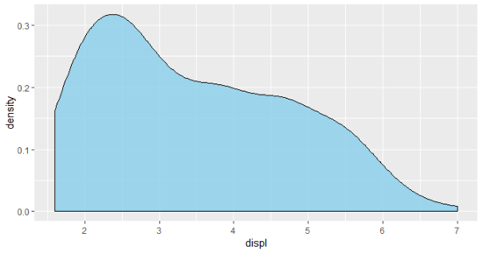
Density – geom_density()
Solution (blank):
ggplot(mpg, aes(x = displ)) +
geom_density()
Solution (area):
ggplot(mpg, aes(x = displ)) +
geom_density(fill = "skyblue",
alpha = 0.8)

Slide 42
Density – geom_density()
Q :
How is density of engine displacement?
How is density of engine displacement by type of car (class)?
A :
Use mpg dataframe
Mapping displ variable to x in aes()
Mapping class variable to fill in aes()
Use geom_density()

Slide 43
Density – geom_density()
Solution:
ggplot(mpg, aes(x = displ, fill = class, color = class)) +
geom_density(alpha = 0.8)

Slide 44
Boxplot

Slide 45
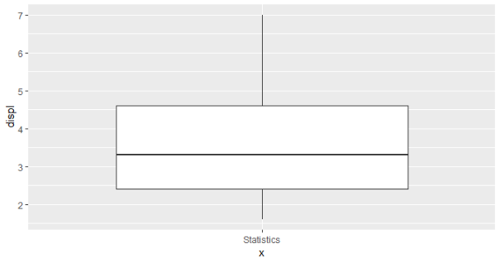
Boxplot – geom_boxplot()
Q :
How is the summarise of engine displacement?
A :
Use mpg dataframe
Mapping "" (blank) to x in aes()
Mapping displ variable to y in aes()
Use geom_boxplot()

Slide 46
Boxplot – geom_boxplot()
Solution:
ggplot(mpg, aes(x = "", y = displ)) +
geom_boxplot()

Slide 47
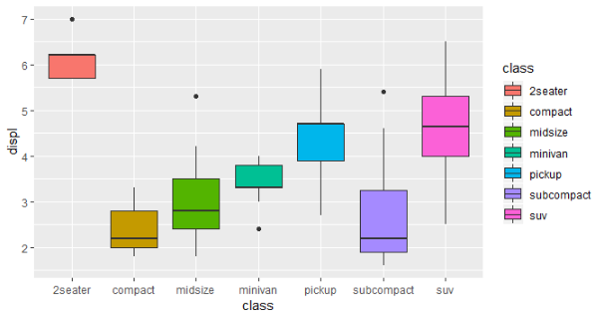
Boxplot – geom_boxplot()
Q :
How is the summarise of engine displacement?
How is the summarise of engine displacement by type of car (class)?
A :
Use mpg dataframe
Mapping class variable to x in aes()
Mapping displ variable to y in aes()
Use geom_boxplot()

Slide 48
Boxplot – geom_boxplot()
Solution:
ggplot(mpg, aes(x = class, y = displ, fill = class)) +
geom_boxplot()

Slide 49
Flipped Boxplot – geom_boxplot()
Solution:
ggplot(mpg, aes(x = class, y = displ, fill = class)) +
geom_boxplot() + coord_flip() +
theme(legend.position = "none")

Slide 50
Scatterplot

Slide 51
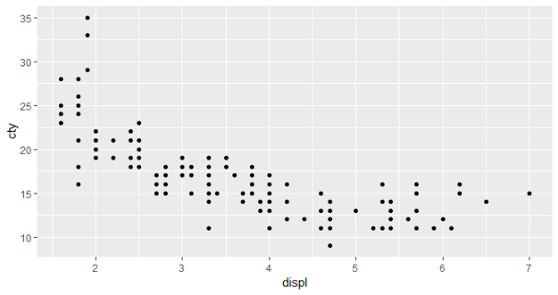
Scatterplot – geom_point()
Q :
How is the scatterplot of engine displacement vs cty?
A :
Use mpg dataframe
Mapping displ variable to x in aes()
Mapping cty variable to y in aes()
Use geom_point()

Slide 52
Scatterplot – geom_point()
Solution:
ggplot(mpg, aes(x = displ, y = cty)) +
geom_point()

Slide 53
Scatterplot – geom_point()
Q :
How is the scatterplot of engine displacement vs cty?
How is the scatterplot of engine displacement vs cty by class?
A :
Use mpg dataframe
Mapping displ variable to x in aes()
Mapping cty variable to y in aes()
Mapping class variable to fill in aes()
Use geom_point()

Slide 54
Scatterplot – geom_point()
Solution:
ggplot(mpg, aes(x = displ, y = cty, fill = class)) +
geom_point()

Slide 55
Line plot

Slide 56
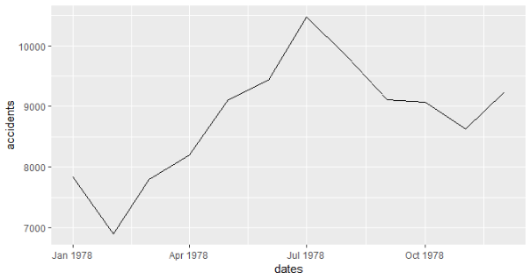
Line plot – geom_line()
Q :
How is the trend of accidental deaths in US?
A :
Use dt_times dataframe
Mapping dates variable to x in aes()
Mapping accidents variable to y in aes()
Use geom_line()
USAccDeaths
dt_times <- data.frame(
dates = seq.Date(from = as.Date("1973-01-01"),
to = as.Date("1978-12-01"),
by = "month"),
accidents = as.vector(USAccDeaths)
)
dt_times <- subset(dt_times,
dates >= as.Date("1978-01-01"))

Slide 57
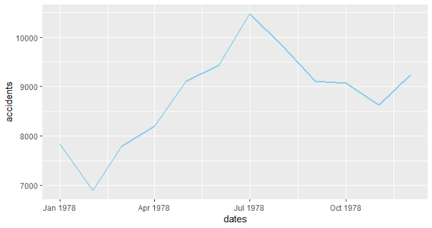
Line plot – geom_line()
Solution (default):
ggplot(dt_times, aes(x = dates, y = accidents)) +
geom_line()
Solution (color):
ggplot(dt_times, aes(x = dates, y = accidents)) +
geom_line(size = 1, color = "skyblue")

Slide 58
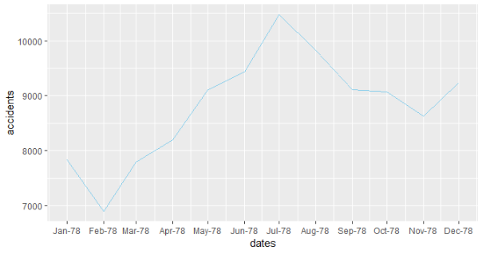
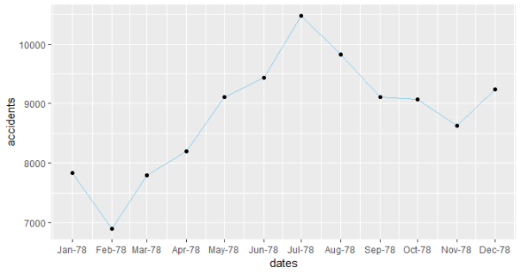
Line plot – geom_line()
Axis labels :
ggplot(dt_times, aes(x = dates, y = accidents)) +
geom_line(color = "skyblue") +
scale_x_date(breaks = "month", date_labels = "%b-%y")
Add point:
ggplot(dt_times, aes(x = dates, y = accidents)) +
geom_line(color = "skyblue") +
geom_point() +
scale_x_date(breaks = "month", date_labels = "%b-%y")

Slide 59
Facet

Slide 60
Facet – facet_wrap()
Q :
From the density chart, separate each density to multi-panel
A :
Use the code to produce density chart
Add layer facet_wrap()
Add class variable to facet argument

Slide 61
Facet – facet_wrap()
Solution:
ggplot(mpg, aes(x = displ, fill = class, color = class)) +
geom_density(alpha = 0.8) + +
facet_wrap(facets = vars(class))

Slide 62
Annotation

Slide 63
Annotation
Add title, change x-label, y-label & legend’s title:
ggplot(mpg, aes(x = displ, fill = class, color = class)) +
geom_density(alpha = 0.8) +
labs(title = "Density Chart of Engine Displacement",
x = "Engine Displacement (litres)", y = "Density",
fill = "Car Type", color = "Car Type")

Slide 64
Theme

Slide 65
Theme
Change theme of the graphic:
g <- ggplot(mpg, aes(x = displ, fill = class, color = class)) +
geom_density(alpha = 0.8) +
labs(title = "Density Chart of Engine Displacement",
x = "Engine Displacement (litres)", y = "Density",
fill = "Car Type", color = "Car Type")
g # print(g)

Slide 66
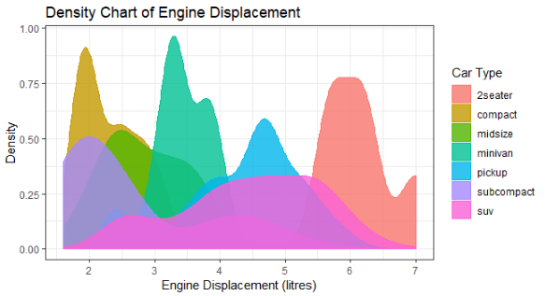
Theme – theme_bw()
Change theme of the graphic :
g +
theme_bw()

Slide 67
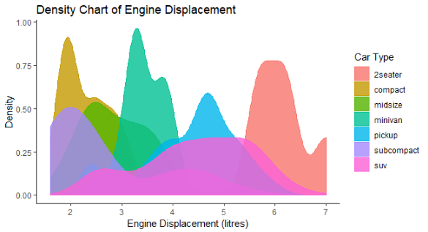
Theme – theme_classic()
Change theme of the graphic :
g +
theme_classic()

Slide 68

Theme – theme_minimal()
Change theme of the graphic :
g +
theme_minimal()

Slide 69
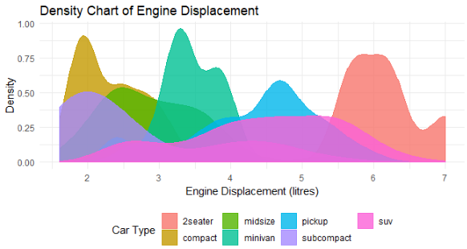
Theme – theme()
Change legend’s position:
g +
theme_minimal() +
theme(legend.position = "bottom")

Slide 70

Theme – theme()
Change legend’s position :
g +
theme_minimal() +
theme(legend.position = "none")

Slide 71
Theme – theme()
Change grid :
g +
theme_minimal() +
theme(legend.position = "none", panel.grid.minor = element_blank())

Slide 72
??? {Q & A}

Slide 73
ThankQ

